Slide 1
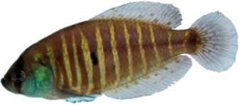

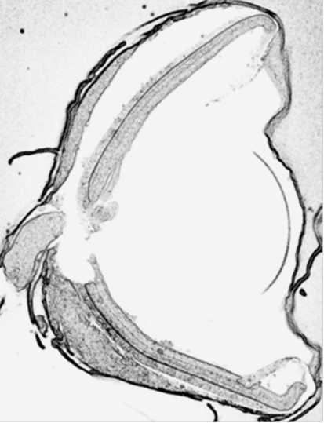
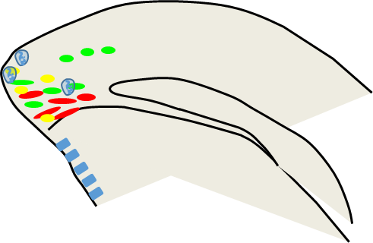
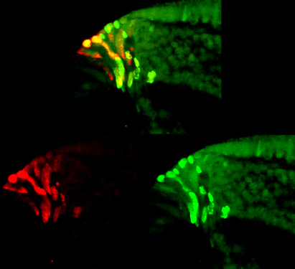
Figure 1
A
30 days postinjection
Day 0
IdU i.p.
Day 29
CldU i.p.
Day 30
i.c.fixation
1 day postinjection
B
D
CMZ
CMZ
 | IdU +
 | CldU+
 | IdU/CldU+
 | mitosis
 | CE
Neural Retina
CE
ON
CMZ
P
A
IdU/CldU+
IdU
CldU
V

